Slide 1
Session 8: Architecture
MIS 6311-501 Cyber Security Fundamentals
Chris Davis

Slide 2
Housekeeping
Any Questions? Please do not hesitate to email. Or text.
Class Website: https://elearning.utdallas.edu
Dropbox: https://goo.gl/9AFyoE
UTD Email: cmd140430@utdallas.edu
Gmail: davischr2@gmail.com
Google Voice: 214-771-8122 (Text & Emergencies)
LinkedIn: www.LinkedIn.com/in/ChristopherDavis
Blog: www.cloudauditcontrols.com
Class: Monday 7:00pm-9:45pm JSOM 12.210

Slide 3
Academic Calendar & Sessions

Slide 4
Comparison of Our Class to CISSP Domains
Shon Harris Book – Chapters
Current CISSP Domains
2
Information Security Governance and Risk Management
8
Business Continuity and Disaster Recovery Planning
Security and Risk Management
9
Legal, Regulations, Investigations and Compliance
7
Cryptography
Security Engineering
4
Security Architecture and Design
Security Assessment and Testing
5
Physical (Environmental) Security
Asset Security
6
Telecommunications and Network Security
Communications and Network Security
3
Access Control
Identity and Access Management
11
Operations Security
Security Operations
10
Software Development Security
Software Development Security

Slide 5
Tales from the Crypt.
Practical Applications & Lessons Learned.

Slide 6
WHAT HAS HAPPENED IN YOUR LIFE?
TWO QUESTIONS FOR YOU.
IS YOUR LIFE AND EXCUSE FOR FAILURE?
OR… IS YOUR LIFE A REASON TO FIGHT?

Slide 7
Job Information – IBM
Below is the link to the Brass Ring employment site for IBM. If you follow that link and click on "Search Experienced Professional Jobs" button you will be taken to a search function. The best way to search is by the Posting ID (number beside titles below). I have all of the following positions open accept the last two. Those are openings on Val's team. Please feel free to shop this data to your students that may be interested. I will also let you know when my managers will be at UTD to work with the job placement staff at the school. That will give your students that can attend an opportunity to ask questions and meet the persons they will be working directly for.
http://www-03.ibm.com/employment/us/
Manager, Security Operations Center - 62640BR
QRadar Correlation Engineer - 61813BR
Data Security Analyst III - 62652BR
Penetration Tester - 62036BR
Data Security Analyst I - 62243BR
Vulnerability Analyst - 62626BR
Manager of Platform Assurance - 64224BR
Risk Analysts - 63559BR

Slide 8
Job Information – TSP
Bridget Watson (bridget.watson@mytsp.net
Level 1 SOC Team Member
Required Experience: 2 – 3 years as a Windows system administrator in a large-scale heterogeneous corporate environment.
Preferred additional experience: 1 – 2 years network security monitoring. Malware analysis, incident response, endpoint protection, using SIEM tools.
Candidate should have a strong desire to provide world-class support and be highly skilled in communicating with the end user community and team mates. Candidate should demonstrate strong customer service, verbal, documentation and listening skills. Candidate should demonstrate the ability to access, triage, and determine criticality of issues or incidents.
Initial required certification: CompTIA Security+
Preferred certification: EC-Council Certified Incident Handler (ECIH) or GIAC Certified Incident Handler (GCIH).
A team member will be responsible for:
Monitoring alerts in various tools
Performing initial triage analysis
Incident creation
Work the alerts to resolution or escalation
Simple issue resolution based on documentation or guidance from Team Leader
Receiving and documenting incident and service requests via web tickets or phone calls or emails and convert them to tickets
Incident management, Escalations

Slide 9
Job Information – Critical Start

Slide 10
VSAQ - Vendor Security Assessment Questionnaires
https://github.com/google/vsaq
https://vsaq-demo.withgoogle.com
VSAQ - Vendor Security Assessment Questionnaires
Web Application Security Questionnaire
Security & Privacy Program Questionnaire
Infrastructure Security Questionnaire
Physical & Datacenter Security Questionnaire

Slide 11
Recommended Classes
Classes that “most” directly translated into value for my own personal experience = YMMV
Organizational Behavior
Advanced Corporate Finance
Strategic Analysis for High Technology Industries
Process
Entrepreneurial Classes
Project Management
Hottest things going right now = IMHO
Cloud Computing
IOT
Security
Development
Notes:
19 Mar 2015 at 01:31, Darren Pauli
http://www.theregister.co.uk/2015/03/19/cansecwest_talk_bioses_hack/
Millions of flawed BIOSes can be infected using simple two-minute attacks that don't require technical skills and require only access to a PC to execute.
Basic Input/Output Systems (BIOS) have been the target of much hacking research in recent years since low-level p0wnage can grant attackers the highest privileges, persistence and stealth.
LegbaCore researchers Xeno Kopvah and Corey Kallenberg revealed the threat to El Reg ahead of a presentation How Many Million BIOSes Would You Like to Infect? at CanSecWest tomorrow.
"Because almost no one patches their BIOSes, almost every BIOS in the wild is affected by at least one vulnerability, and can be infected," Kopvah says.
"The high amount of code reuse across UEFI BIOSes means that BIOS infection can be automatic and reliable.
"The point is less about how vendors don't fix the problems, and more how the vendors' fixes are going un-applied by users, corporations, and governments."
Kopvah and Kallenberg's talk aims to both highlight the dangers and capabilities of BIOS attacks and the need for system administrators to apply vendor patches, something which they say is not being done.
They will demonstrate attacks against BIOS on Gigabyte, Acer, MSI, HP, and Asus, using the LightEater implant running the privacy-focused Tails platform to siphon GPG keys from memory to a flash chip.
LightEater, according to Kopvah, reveals the naïveté of claims that Tails and other live operating systems can protect users from dedicated or nation-state attackers.
The LightEater attack would take an unskilled attacker such as a maid or border guard two minutes of physical access to a target laptop.
"Then we'll boot up the infected HP system and show how LightEater can use the Intel Serial Over LAN technology to exfiltrate data from SMM (System Management Mode), without needing a NIC-specific driver. And we'll show the uber1337 'rot13' encryption which will blind network defenders to what the SMM attacker is exfiltrating," he says.
Kopvah says misconfigured BIOS access controls present more of a threat than vulnerabilities such as exploitable buffer overflows.
Those flaws are homogeneous. Using tiny signatures built from 10 machines the pair found the code hooks attackers need to build reliable SMM implants across thousands of BIOS images.
"This shows empirically that attackers wouldn't have to reverse engineer each BIOS model or revision. Simple pattern matching can make it so that tools can just assemble BIOS implants for any model on demand," Kopvah says, adding he expects that attackers already know this.
The need for better BIOS security is "starting to sink in" with top vendors (Lenovo, Dell and HP) moving to squash flaws in their gear. ASUS Kopvah says a good example of those which had not patched or acknowledged BIOS flaws.
Some BIOSes are woefully insecure. The pair found Giagbyte's BIOS had borked access controls that did nothing to prevent attacks.
"So, we didn't even have to do anything special; we just had a kernel driver write an invalid instruction to the first instruction the CPU reads off the flash chip, and bam, it was out for the count, and never was able to boot again," Kopvah says.
The duo will reveal an automated scripts they supplied to vendors that can detect dangerous attacks against SMM capable of reading and writing to all system memory.
BIOS attacks surfaced on the public record from the research community but as leaked Snowden documents reveal it was the National Security Agency that likely first exploited the vector.
The research pair says the attacks should serve as a boot in the arse for governments and corporations to apply BIOS patches if only to make life more difficult for less-resourced hostile spy agencies.
"I personally find it very ironic that things like Tails gained popularity as OPSEC tools thanks to Snowden, while at the same time Snowden's leaks showed that the NSA had the capability to defeat such mechanisms if they wanted to." ®

Slide 12
Let’s Get Started.

Slide 13
Session Contents
This chapter presents the following:
System architecture • Computer hardware architecture • Operating system architecture • System security architecture • Trusted computing base and security mechanisms • Information security software models • Assurance evaluation criteria and ratings • Certification and accreditation processes
Notes:
The architecture of a computer system is very important and comprises many topics. The system has to ensure that memory is properly segregated and protected , ensure that only authorized subjects access objects, ensure that untrusted processes cannot perform activities that would put other processes at risk, control the flow of information, and define a domain of resources for each subject. It also must ensure that if the computer experiences any type of disruption, it will not result in an insecure state. Many of these issues are dealt with in the system’s security policy , and the security model is built to support the requirements of this policy. Once the security policy, model, and architecture have been developed, the computer operating system, or product, must be built, tested, evaluated, and rated. An evaluation is done by comparing the system to predefined criteria. The rating assigned to the system depends upon how it fulfills the requirements of the criteria. Customers use this rating to understand what they are really buying and how much they can trust this new product. Once the customer buys the product, it must be tested within their own environment to make sure it meets their company’s needs, which takes place through certification and accreditation processes.
Harris, Shon (2012-11-08). CISSP All-in-One Exam Guide, 6th Edition (Kindle Locations 8633-8641). McGraw-Hill Education. Kindle Edition.
Security terminology and principles • Protection control types • Security frameworks, models, standards, and best practices • Security enterprise architecture • Risk management • Security documentation • Information classification and protection • Security awareness training • Security governance
Harris, Shon (2012-11-08). CISSP All-in-One Exam Guide, 6th Edition (Kindle Locations 1007-1011). McGraw-Hill Education. Kindle Edition.

Slide 14
Chris's View

Slide 15
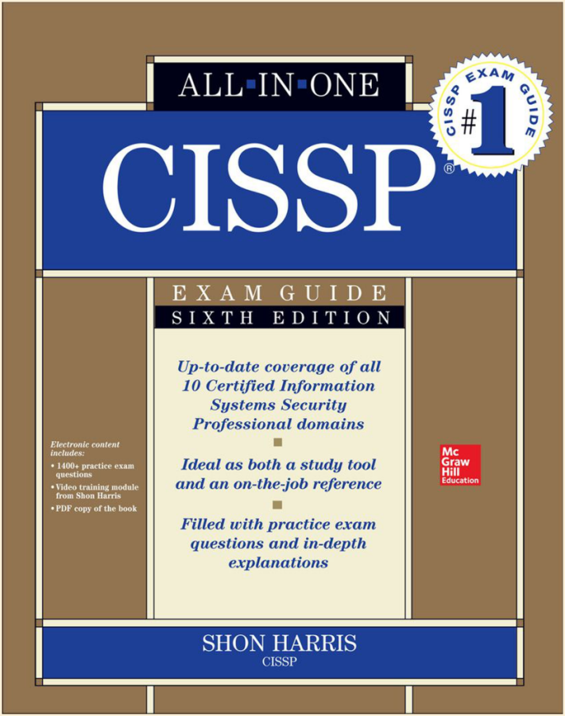
Today's Materials
Harris, Shon (2012-11-08).
CISSP All-in-One Exam Guide, 6th Edition.
McGraw-Hill Education.

Slide 16
CHAPTER 4 Security Architecture and Design

Slide 17
System Architecture

Slide 18
Key Terms
ISO/ IEC/ IEEE 42010, Systems and software engineering— Architecture description -- The goal is to internationally standardize how system architecture takes place instead of product developers just “winging it” and coming up with their own proprietary approaches. A disciplined approach to system architecture allows for better quality, interoperability, extensibility, portability, and security.
Architecture -- Fundamental organization of a system embodied in its components, their relationships to each other and to the environment, and the principles guiding its design and evolution.
Architectural Description (AD) -- Collection of document types to convey an architecture in a formal manner.
Stakeholder -- Individual , team, or organization (or classes thereof ) with interests in, or concerns relative to, a system.
View -- Representation of a whole system from the perspective of a related set of concerns.
Viewpoint -- A specification of the conventions for constructing and using a view. A template from which to develop individual views by establishing the purposes and audience for a view and the techniques for its creation and analysis.

Slide 19
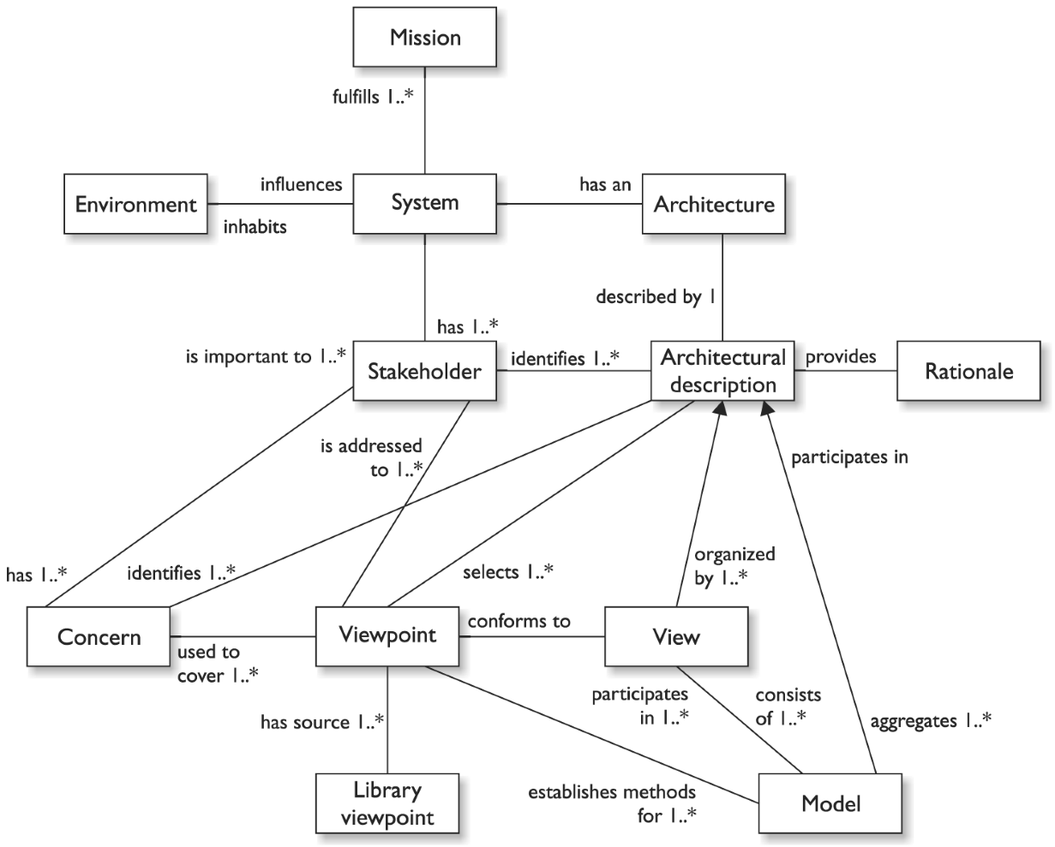
Formal Architecture Terms and Relationships

Slide 20
Computer Architecture

Slide 21
Why Architect in the First place
Solutions are the result of concerted efforts
Saves Money
Fixing problems up front cheaper than fixing in the field.
Improves Quality and productivity
re-use is good, architecture is about re-use
Brian E. Brzezicki

Slide 22
Architecture
Architecture encompasses all of the components of a computer, including
Operating System (Windows, Linux, Solaris etc)
Memory (next)
CPU
Storage (Hard Drives, IDE/ATA, SCSI, Fibre Channel)
I/O devices
Security components
Networking
Brian E. Brzezicki

Slide 23
Architecture Cont..
Functionality and security of the system depends upon the interaction of these components.
One component fails, the whole system is insecure.
Brian E. Brzezicki

Slide 24
CPU
CPU – the brain of a computer. Which consists of
Control unit – fetches instructions for the Arithmetic logic unit (ALU) to execute.
Manages synchronization of data being processed.
ALU – executes instructions which are usually
Mathematical operations
Logical operations (AND, OR)
Memory Accesses
Registers (next slide)
Brian E. Brzezicki

Slide 25
CPU States
Supervisor State
Kernel / Protected / Privileged mode
Ring Zero
Program can access entire system
Problem State
User / Program mode
Ring three
Only non-privileged instructions are executed
Intended for applications.
Brian E. Brzezicki

Slide 26
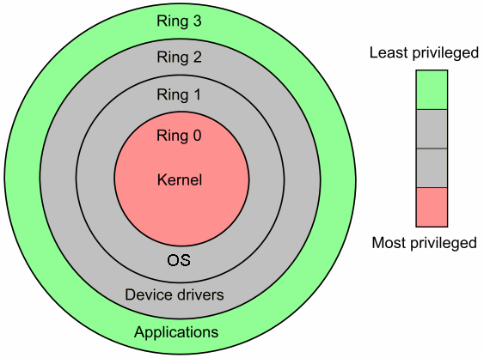
CPU Modes and protection rings
Operating system security methods
Privilege level
Windows: admin, user, guest
Unix: root, non-root
Protection ring
Ring 0: kernel
Ring 1: OS
Ring 2: device drivers
Ring 3: user processes
Brian E. Brzezicki

Slide 27
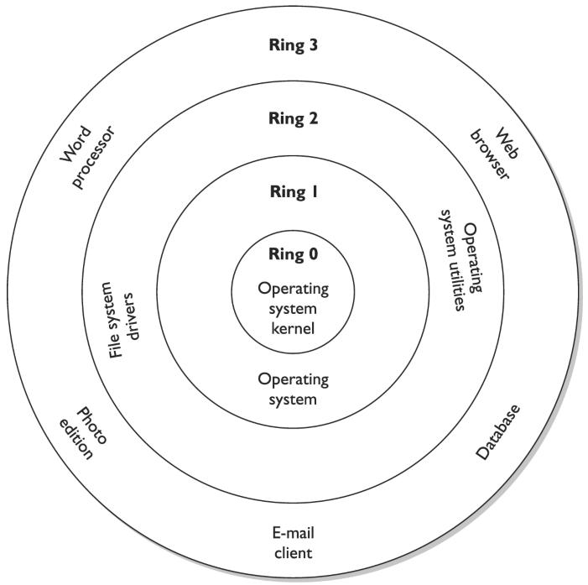
Protection Rings

Slide 28
CPU Modes and Protection Rings
The operating Systems protects itself by segmenting it’s components into rings, Each inner ring is more privileged and provides services on behalf of the outer rings. The Number of rings an OS can have is dependant on the type of processor that it runs on.
Code in one ring can only access other objects in the same ring, or request a service from the ring beneath it based on well defined standards/APIs
Brian E. Brzezicki

Slide 29
Wrap up on OS Modes and Protection Rings
Rings allow the OS to place different components at different levels of security. Things at each level are in the same execution domain
Each level closer to the middle is more trusted
Each inner level provides services for an outer level. (give an example, i.e. write system call)
Brian E. Brzezicki

Slide 30
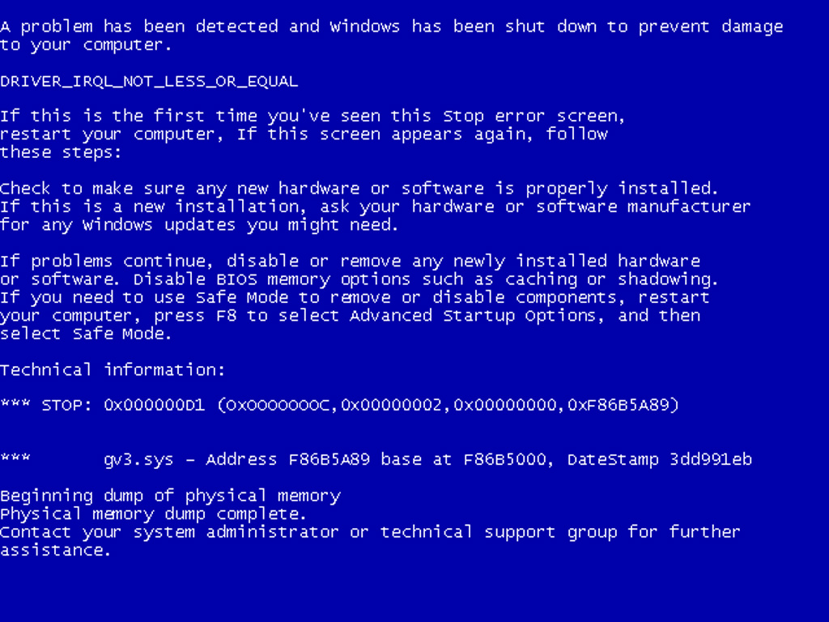
Example of CPU Zero Bad Drivers
Brian E. Brzezicki

Slide 31
Operating Systems Architecture
The operating system can be designed based on multiple models
Monolithic kernel* – means all kernel code runs in privileged mode
Microkernel – minimal kernel services that run in privileged mode and provide services to other kernel components in user mode
Note when code is running as part of the OS kernel. it is running in privileged mode
Brian E. Brzezicki

Slide 32
Registers
Registers – small extremely fast memory locations located directly on the CPU.
General purpose registers – variables
special registers – hold special values
The Program Counter is a special register, which holds the address in memory of the next instruction to be executed (EIP on Intel IA32*)
Program Status Word – contains flags that describe the status of instructions being run.
Stack Pointer – (ESP on Intel IA32)
Brian E. Brzezicki

Slide 33
Registers
User-accessible registers – The most common division of user-accessible registers is into data registers and address registers.
Data registers can hold numeric values such as integer and floating-point values, as well as characters, small bit arrays and other data. In some older and low end CPUs, a special data register, known as the accumulator, is used implicitly for many operations.
Address registers hold addresses and are used by instructions that indirectly access primary memory.
Some processors contain registers that may only be used to hold an address or only to hold numeric values (in some cases used as an index register whose value is added as an offset from some address); others allow registers to hold either kind of quantity. A wide variety of possible addressing modes, used to specify the effective address of an operand, exist.
The stack pointer is used to manage the run-time stack. Rarely, other data stacks are addressed by dedicated address registers, see stack machine.

Slide 34
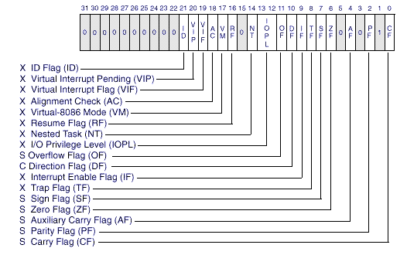
Program Status Word
Brian E. Brzezicki

Slide 35
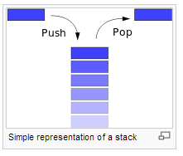
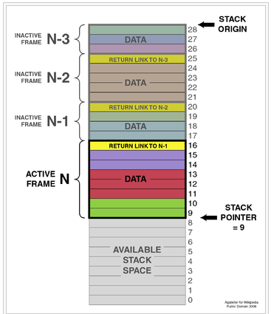
A Typical Stack
A typical stack, storing local data and call information for nested procedure calls (not necessarily nested procedures!). This stack grows downward from its origin. The stack pointer points to the current topmost datum on the stack. A push operation decrements the pointer and copies the data to the stack; a pop operation copies data from the stack and then increments the pointer. Each procedure called in the program stores procedure return information (in yellow) and local data (in other colors) by pushing them onto the stack. This type of stack implementation is extremely common, but it is vulnerable to buffer overflow attacks.

Slide 36
External Components
Address Bus – a series of wires that the CPU and other components share that provide access to a memory ADDRESS to access
Data Bus – a series of wires that the CPU and other components share that deliver the actual DATA for the memory location currently being accessed
(see visualization)
Brian E. Brzezicki

Slide 37
Memory Access
Address (Bus) | Data (Bus)
00000101 (5) | 00100010 (34)
If the CPU wants to access memory location 5, it would put 00000101 on the ADDRESS BUS and issues a READ request.
The memory controller would look up the value in memory location 5 and return the value on the DATA bus, in this case if memory location 5 had the number 34 stored in it. The value returned on the DATA bus would be binary 34 (00100010)
(visualization on next slides)
Brian E. Brzezicki

Slide 38
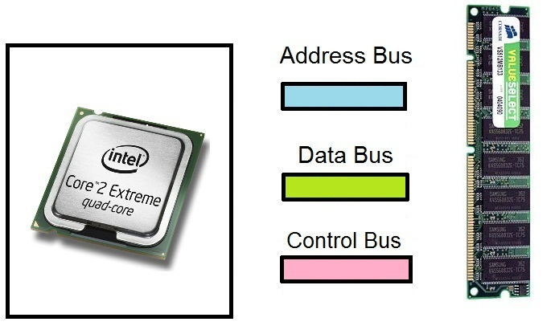
Memory Buses (read example)
Brian E. Brzezicki

Slide 39
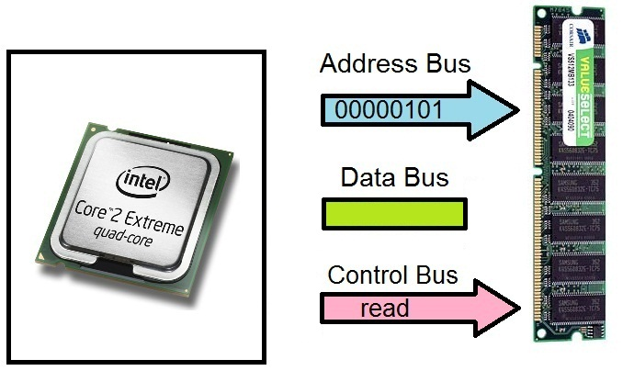
Memory Buses (read example)
Brian E. Brzezicki

Slide 40
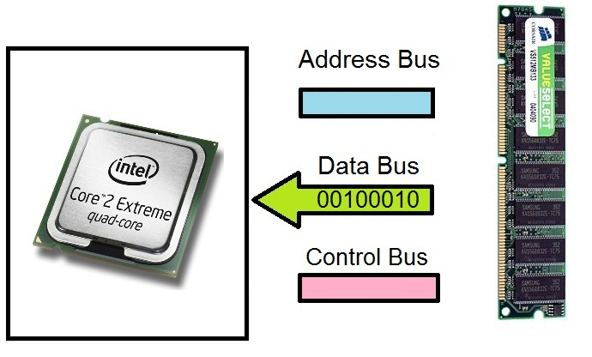
Memory Buses (read example)
Brian E. Brzezicki

Slide 41
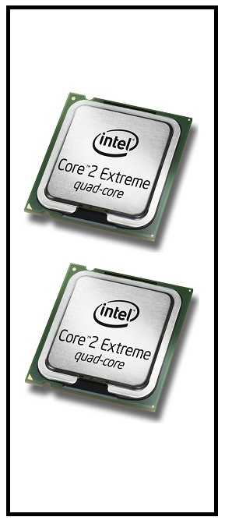
Multiprocessing
Some computers have more than one CPU.
Brian E. Brzezicki

Slide 42
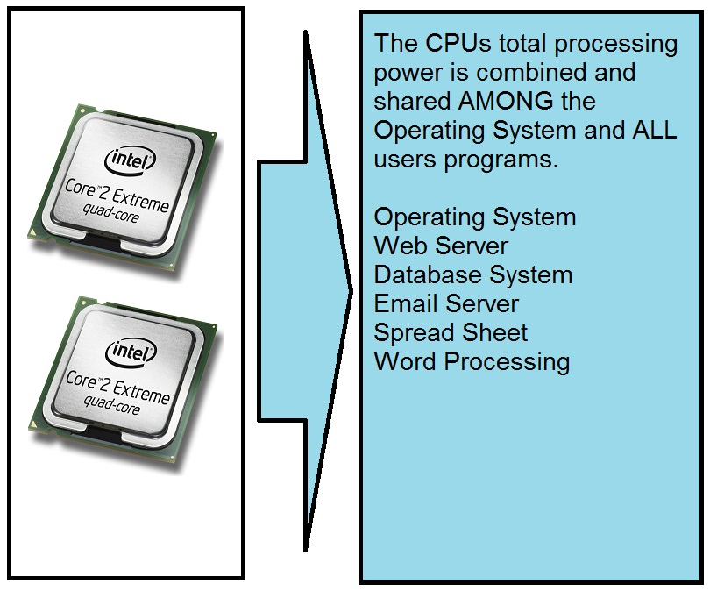
Symmetric Multiprocessing
Brian E. Brzezicki

Slide 43
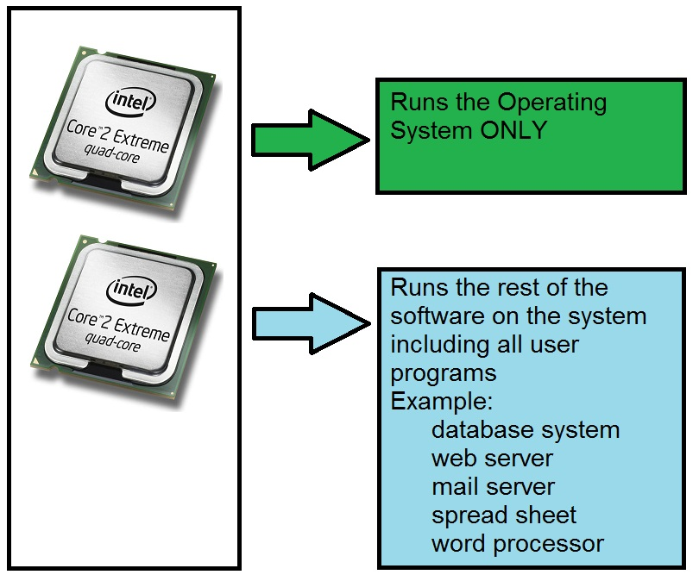
Asymmetric Multiprocessing
1 or more processors are dedicated for the OS. Usually used in time-sensitive or real-time systems. (Like flight control systems)
Brian E. Brzezicki

Slide 44
Key Terms – Computer Architecture
ISO/ IEC 42010: 2007 -- International standard that provides guidelines on how to create and maintain system architectures.
Central processing unit (CPU) -- A silicon component made up of integrated chips with millions of transistors that carry out the execution of instructions within a computer.
Arithmetic logic unit (ALU) -- Component of the CPU that carries out logic and mathematical functions as they are laid out in the programming code being processed by the CPU.
Register -- Small, temporary memory storage units integrated and used by the CPU during its processing functions.
Control unit -- Part of the CPU that oversees the collection of instructions and data from memory and how they are passed to the processing components of the CPU.
General registers -- Temporary memory location the CPU uses during its processes of executing instructions. The ALU’s “scratch pad” it uses while carrying out logic and math functions.

Slide 45
Key Terms – Computer Architecture
Special registers -- Temporary memory location that holds critical processing parameters. They hold values as in the program counter, stack pointer, and program status word.
Program counter -- Holds the memory address for the following instructions the CPU needs to act upon.
Stack -- Memory segment used by processes to communicate instructions and data to each other.
Program status word -- Condition variable that indicates to the CPU what mode (kernel or user) instructions need to be carried out in.
User mode (problem state) -- Protection mode that a CPU works within when carrying out less trusted process instructions.
Kernel mode (supervisory state, privilege mode) -- Mode that a CPU works within when carrying out more trusted process instructions. The process has access to more computer resources when working in kernel versus user mode.

Slide 46
Key Terms – Computer Architecture
Address bus -- Physical connections between processing components and memory segments used to communicate the physical memory addresses being used during processing procedures.
Data bus -- Physical connections between processing components and memory segments used to transmit data being used during processing procedures.
Symmetric mode multiprocessing -- When a computer has two or more CPUs and each CPU is being used in a load-balancing method.
Asymmetric mode multiprocessing -- When a computer has two or more CPUs and one CPU is dedicated to a specific program while the other CPUs carry out general processing procedures.

Slide 47
Operating System Components

Slide 48
Process management
A process is a computer program that is actually running on a computer. (like Firefox, or MS Word).
Brian E. Brzezicki

Slide 49
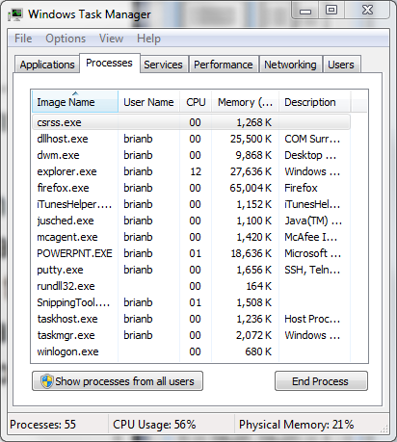
Multiprogramming
Multi-programming means that can be running more than one process at a time… Even if there is only 1 CPU…how does this happen?
Brian E. Brzezicki

Slide 50
Time Slicing (1 second)
Time Period | Program Running
0-99 milliseconds | MS Word
100-199 milliseconds | Firefox (web browser)
200-299 milliseconds | MS Excel
300-399 milliseconds | Adobe Photoshop
400-499 milliseconds | Windows Explorer
500-599 milliseconds | MS PowerPoint
600-699 milliseconds | Operating System
700-799 milliseconds | Adobe Acrobat Reader
800-899 milliseconds | Anti-Virus
900-999 milliseconds | Thunderbird (email)
Brian E. Brzezicki

Slide 51
Multi-programming
Co-operative multitasking (used in windows 3.1) – one process must specifically release it’s control of the CPU before another can use the processor.
Pros?
Cons?
Pre-emptive multitasking – The Operating System takes the processor away from one program and gives it to another in a scheduled manner.
Pros?
Cons?
Brian E. Brzezicki

Slide 52
Multi-programming
When there are multiple processes on a computer, these processes can be in one of these states
Running
process is actually using the CPU
Blocked
process is waiting for some input that it expects immediately, gives up CPU
Sleeping
process is waiting for some input but does not expect it for a while, gives up CPU
The processes, their states, and specific information (memory allocation, open files… etc) are stored in a “process table”
Brian E. Brzezicki

Slide 53
Process Table
Program | PID | State | State Info
Firefox | 1453 | Running | SP=19024, PC=20000 Memory allocation=…
telnet | 754 | Blocked | SP=1024, PC=2043 Memory allocation=…
mysql | 56 | Sleeping | SP=40112, PC=4321 Memory allocation=…
httpd | 1014 | Sleeping | SP=74123, PC=65123 Memory allocation=…
Brian E. Brzezicki

Slide 54
Multi-programming
If a process needs to signal the CPU to perform some action it generates an interrupt. Interrupts tell the CPU to stop what it’s doing and take some action on behalf of the process.
Interrupts fall into two categories
Mask able
Non-mask able
Brian E. Brzezicki

Slide 55
A thread
A thread is the set of instructions that will be run on a CPU. (this is also the definition of a process)
On modern OS’s threads rather than processes are scheduled for execution.
A process may be made up of multiple threads.
Thread usually handle some specific part of a program where a program wants to do two or more actions at the same time. (Example, printing, etc.)
Brian E. Brzezicki

Slide 56
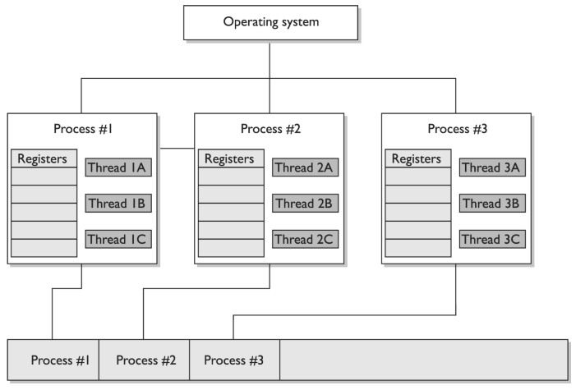

Slide 57
Multi-threaded program
A program that is written such that different parts of the program can run in parallel. Keep in mind
threads can share resources like memory natively. Processes cannot.
Brian E. Brzezicki

Slide 58
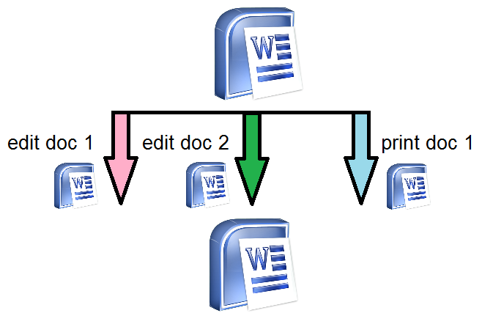
Thread
Process
Threads
Brian E. Brzezicki

Slide 59
Process/thread scheduling
Scheduling processes is an important job that the OS must perform. The goal is to share the CPU effectively while keeping in mind the current demands for resources.
Concerns with processes scheduling –
Effective resource allocation
Being fair
Time critical (realtime) processes
Brian E. Brzezicki

Slide 60
Ensuring security on Multitasking systems
Computers run multiple processes at the same time. These processes need to be protected from each other. They should not be able to access each others resources either intentionally or accidentally. The OS needs to enforce this. They attempt to do this using process isolation which provides the following services.
(next slides)
Brian E. Brzezicki

Slide 61
Ensuring security on Multitasking systems
Encapsulation – No process can interact with another process. One process cannot read/write to the process space of another, or even communicate with another process without using some external interface/communications channel.
(visual next slide)
Brian E. Brzezicki

Slide 62
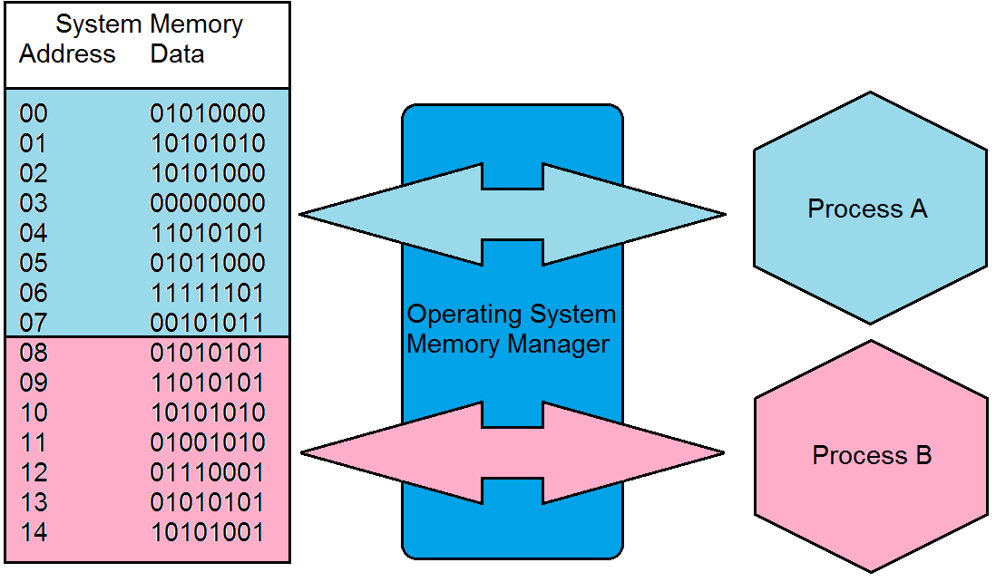
Memory Encapsulation/Isolation
Brian E. Brzezicki

Slide 63
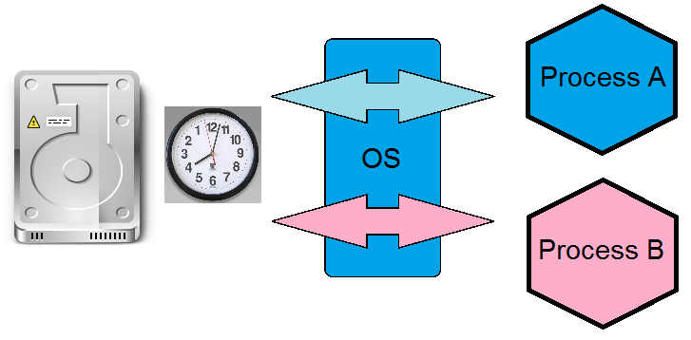
Ensuring security on Multitasking systems
Time Multiplexing – Allows processes to share resources. They do this by each using the resources for a fraction of time.
Brian E. Brzezicki

Slide 64
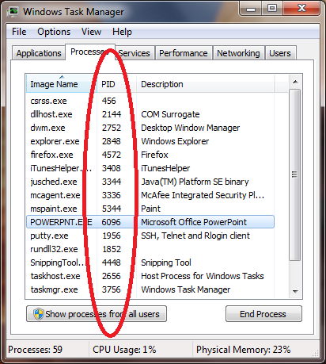
Ensuring security on Multitasking systems
Naming Distinctions – Each process has it’s own name or id. In Unix and Windows processes have a PID (process id)
Brian E. Brzezicki

Slide 65
Ensuring security on Multitasking systems
Virtual Mapping – A process thinks it’s the only process on the machine (at least with memory)
All processes see the same memory space (0 – maximum process memory). That memory is mapped into actually system memory space by a memory mapper*
(see diagram)
Brian E. Brzezicki

Slide 66
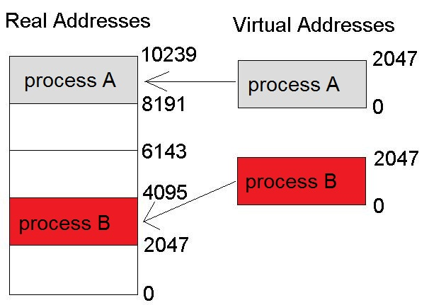
Virtual Mapping
Memory Management: Mapping
Brian E. Brzezicki

Slide 67
Memory Management
Multi-tasking Operating Systems provide memory management. Goals of memory management are
Provide abstraction layer for programmers
Maximize performance with the limited amount of memory
Protect the OS and applications
Programs don’t need to know the amount or type of memory.
Brian E. Brzezicki

Slide 68
Memory Management
Responsibilities of the MM are:
Relocation – swapping, and virtual mapping
Absolute and Logical Addresses*
Real addresses are “Absolute Addresses”
Virtual Addresses are “Logical Addresses”
Brian E. Brzezicki

Slide 69
Memory Management
Protection – isolate processes memory space
Sharing – API for shared memory
Physical Organization – segment the physical memory space for applications and the OS.
Windows userspace 0x0000 – 0x7FFFFFF
Windows kernel space 0x8000000 – 0xFFFFFFFF
Brian E. Brzezicki

Slide 70
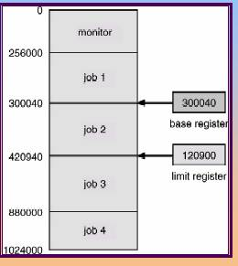
Memory Management
What are some methods that are used for this.
Base and limit registers are used to check memory access.
Base is the start of the memory space
Limit is the end of the memory space
Brian E. Brzezicki

Slide 71
Memory Types
RAM – random-access memory Temporary memory
DRAM – Dynamic RAM which requires refreshing
SRAM – Synchronous dynamic random access memory RAM with no refresh needs, much faster and more expensive.
(more)
Brian E. Brzezicki

Slide 72


Memory Types
SDRAM – timed DRAM
DDR SDRAM – SDRAM which operates on both rising and falling of clock (twice as fast)
Brian E. Brzezicki

Slide 73
Memory Type
ROM – Read Only Memory – non-volatile, non-writable. Good for firmware. Secure as it’s not writable. (why is this secure?)
PROM – Programmable ROM
EPROM – Erasable PROM (UV)
EEPROM – Electrically Erasable PROM that is Erasable but Electronically. (security implications)
Flash Memory – Reprogrammable on the fly
Cache Memory
Brian E. Brzezicki

Slide 74
Other Memory Terms
Memory Leak – Because they can exhaust available system memory as an application runs, memory leaks are often the cause of or a contributing factor to software aging.
Virtual Memory – using secondary storage to virtually expand your memory.
Paging / Swapping
Page frames
Security concerns with paging, both live and reboots. What can you do to protect on reboots?
Brian E. Brzezicki

Slide 75
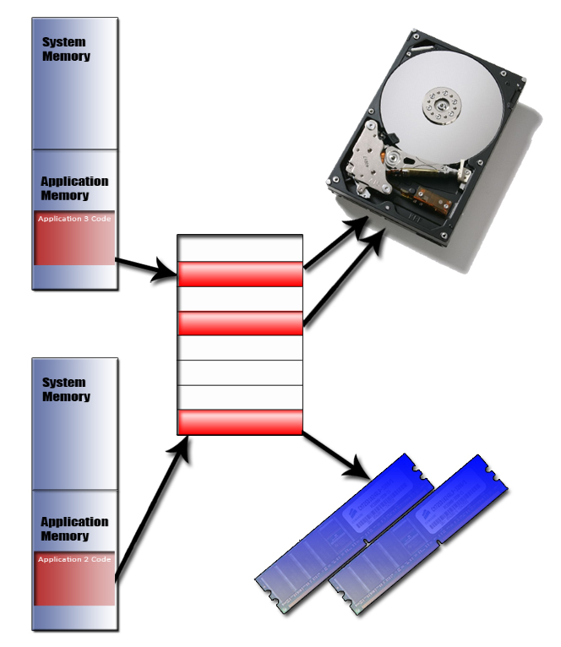
Paging
Brian E. Brzezicki

Slide 76
Key Terms – Operating System Components
Process -- Program loaded in memory within an operating system.
Multiprogramming -- Interleaved execution of more than one program (process) or task by a single operating system.
Multitasking -- Simultaneous execution of more than one program (process) or task by a single operating system.
Cooperative multitasking -- Multitasking scheduling scheme used by older operating systems to allow for computer resource time slicing. Processes had too much control over resources, which would allow for the programs or systems to “hang.”
Preemptive multitasking -- Multitasking scheduling scheme used by operating systems to allow for computer resource time slicing. Used in newer, more stable operating systems.
Process states (ready, running, blocked) -- Processes can be in various activity levels. Ready = waiting for input. Running = instructions being executed by CPU. Blocked = process is “suspended.”

Slide 77
Key Terms – Operating System Components
Interrupts -- Values assigned to computer components (hardware and software) to allow for efficient computer resource time slicing.
Maskable interrupt -- Interrupt value assigned to a noncritical operating system activity.
Nonmaskable interrupt -- Interrupt value assigned to a critical operating system activity.
Thread -- Instruction set generated by a process when it has a specific activity that needs to be carried out by an operating system. When the activity is finished, the thread is destroyed.
Multithreading -- Applications that can carry out multiple activities simultaneously by generating different instruction sets (threads).
Software deadlock -- Two processes cannot complete their activities because they are both waiting for system resources to be released.

Slide 78
Major Operating System Kernel Architectures

Slide 79
Major Operating System Kernel Architectures
The basic core definitions of the different architecture types are as follows:
Monolithic -- All operating system processes run in kernel mode.
Layered -- All operating system processes run in a hierarchical model in kernel mode.
Microkernel -- Core operating system processes run in kernel mode and the remaining ones run in user mode.
Hybrid microkernel -- All operating system processes run in kernel mode. Core processes run within a microkernel and others run in a client\ server model.

Slide 80
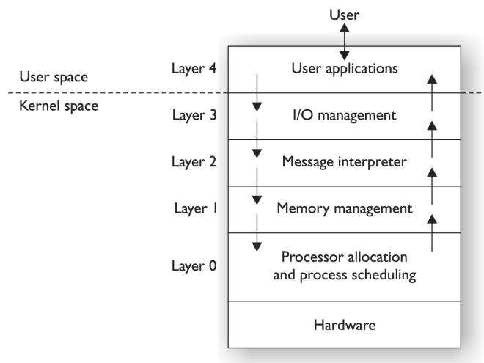
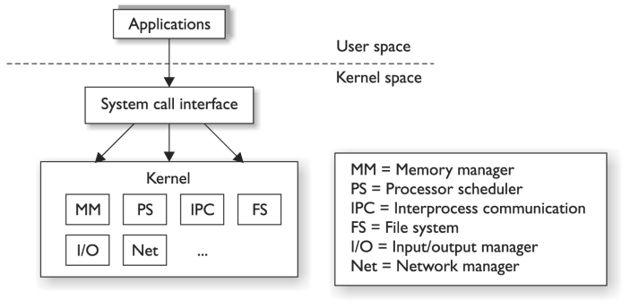
Monolithic vs. Layered Architecture
Monolithic OS Architecture
Layered OS Architecture

Slide 81
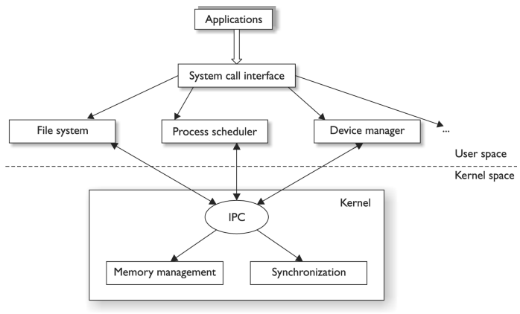
Microkernel Architecture
Microkernel OS Architecture

Slide 82
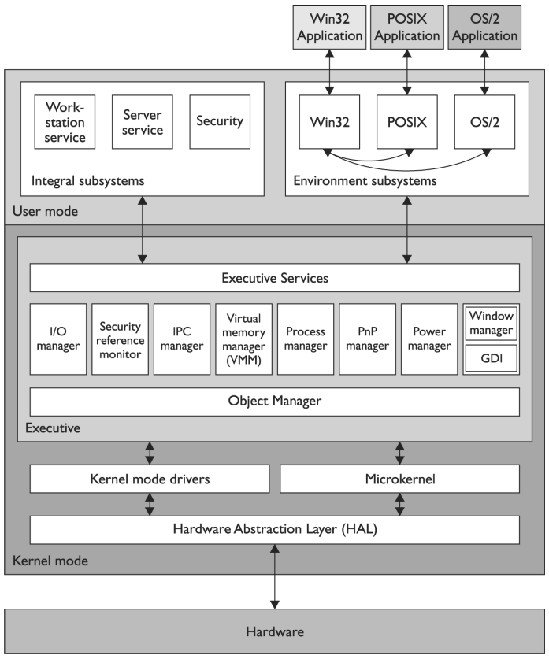
Windows Hybrid Microkernel Architecture

Slide 83
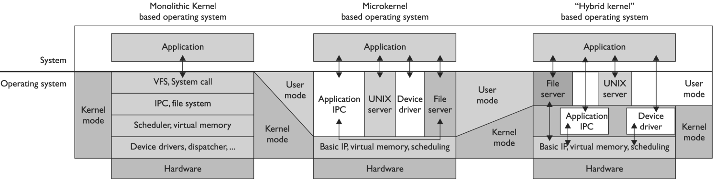
Major Operating System Kernel Architectures

Slide 84
Key Terms – OS Architecture
Interrupt -- Software or hardware signal that indicates that system resources (i.e., CPU) are needed for instruction processing.
Instruction set -- Set of operations and commands that can be implemented by a particular processor (CPU).
Microarchitecture -- Specific design of a microprocessor, which includes physical components (registers, logic gates, ALU, cache, etc.) that support a specific instruction set.
Application Programming Interface (API) -- Software interface that enables process-to-process interaction. Common way to provide access to standard routines to a set of software programs.
Monolithic operating system architecture -- All of the code of the operating system working in kernel mode in an ad hoc and nonmodularized manner.
Layered operating system architecture -- Architecture that separates system functionality into hierarchical layers.

Slide 85
Key Terms – OS Architecture
Data hiding -- Use of segregation in design decisions to protect software components from negatively interacting with each other. Commonly enforced through strict interfaces.
Microkernel architecture -- Reduced amount of code running in kernel mode carrying out critical operating system functionality. Only the absolutely necessary code runs in kernel mode , and the remaining operating system code runs in user mode.
Hybrid microkernel architecture -- Combination of monolithic and microkernel architectures. The microkernel carries out critical operating system functionality, and the remaining functionality is carried out in a client\ server model within kernel mode.
Mode transition -- When the CPU has to change from processing code in user mode to kernel mode. This is a protection measure, but it causes a performance hit.

Slide 86
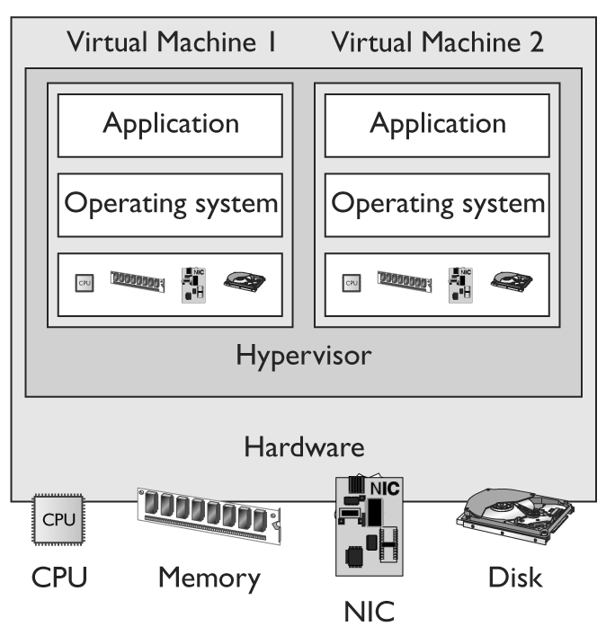
Virtual Machines
What is a virtual machine. What is the purpose of a virtual machine. What are the strengths. How can a virtual machine help strengthen security?
Service isolation
Failover (Availability)
Memory forensics
…
What are some popular virtual environments?
Brian E. Brzezicki

Slide 87
System Security Architecture
Brian E. Brzezicki

Slide 88
System Architecture
A OS should be able to enforce the security principals (CIA). How to properly design and build a system is called “Security System Architecture”.
We are going to talk about some terms that are used when discussing System security Architecture
Brian E. Brzezicki

Slide 89
Security Architecture Terms
TCB – Trusted Computing Base* - the total combination of protection mechanisms within a computer system. This includes hardware, software and firmware. These are part of the TCB because the systems trusts that they will enforce the security policy and not violate it*. The TCB must enforce the security rules strictly AND ensure that that components react in a predictable manner.*
Brian E. Brzezicki

Slide 90
Trusted Computing Base
This term should be internalized, you should be able to name a system component and determine if it’s part of the TCB
Brian E. Brzezicki

Slide 91
Security Perimeter
Not every process falls within the TCB. The security perimeter is the imaginary boundary that divides the trusted from the untrusted. Communications between the trusted and untrusted must be well defined and strictly controlled.
(more)
Brian E. Brzezicki

Slide 92
TCB Check
Quick Quiz: for each component IS it part of the TCB?
Kernel component that determines if a user has access to a specific file by ACL
Web Browser
Biometric reader authentication system
Spread sheet
Brian E. Brzezicki

Slide 93
Security Terms
Note that the TCB does not address the technical level of security the system provides.. Just the level of trust or assurance we have in it.
Trusted Path* – a communications channel between the user/program and the kernel. An example of a trusted path is hitting control-alt-delete on windows. Windows TCB provides that nothing can “intercept that sequence” and when you hit it you will actually be telling the operating system you’d like to login etc.
(more)
Brian E. Brzezicki

Slide 94
Reference Monitor
Reference Monitor – is an abstract machine the mediates all access subjects have to objects. The RM ensures that the subjects have the necessary access rights to the object, as well as protecting the objects from destructive modification.
For a system to have a higher level of trust it must require all subjects are authorized prior to allowing access to an object.
The RM is an abstract or conceptual idea, it’s not an actual piece of code*
(more)
Brian E. Brzezicki

Slide 95
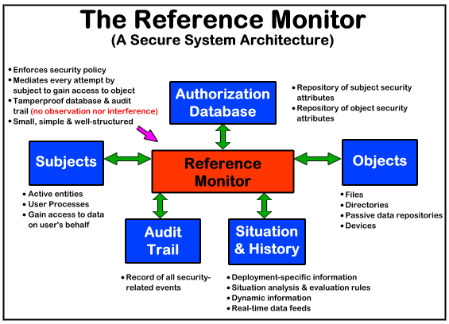
Reference Monitor
Brian E. Brzezicki

Slide 96
Security Kernel (SK)
This is the hardware, software and firmware that fall within the TCB and implements and enforces the reference monitor concept!*
The security kernel must provide the following
Provide isolation for processes carrying out the reference monitor concept, the processes must be tamperproof (why?)*
The SK must be invoked for every access attempt and be impossible to circumvent, therefore it must be foolproof (why?)*
It must be small enough to be tested and verified comprehensively*
Brian E. Brzezicki

Slide 97
Pulling These Concepts Together – Quick Tips
The trusted computing base (TCB) is a collection of system components that enforce the security policy directly and protect the system. These components are within the security perimeter.
Components that make up the TCB are hardware, software, and firmware that provide some type of security protection.
A security perimeter is an imaginary boundary that has trusted components within it (those that make up the TCB) and untrusted components outside it.
The reference monitor concept is an abstract machine that ensures all subjects have the necessary access rights before accessing objects. Therefore, it mediates all access to objects by subjects. The security kernel is the mechanism that actually enforces the rules of the reference monitor concept.
The security kernel must isolate processes carrying out the reference monitor concept, must be tamperproof, must be invoked for each access attempt, and must be small enough to be properly tested.
Processes need to be isolated, which can be done through segmented memory addressing, encapsulation of objects, time multiplexing of shared resources, naming distinctions, and virtual mapping.
Notes:
• The trusted computing base (TCB ) is a collection of system components that enforce the security policy directly and protect the system. These components are within the security perimeter. • Components that make up the TCB are hardware, software, and firmware that provide some type of security protection. • A security perimeter is an imaginary boundary that has trusted components within it (those that make up the TCB) and untrusted components outside it. • The reference monitor concept is an abstract machine that ensures all subjects have the necessary access rights before accessing objects. Therefore, it mediates all access to objects by subjects. • The security kernel is the mechanism that actually enforces the rules of the reference monitor concept. • The security kernel must isolate processes carrying out the reference monitor concept, must be tamperproof, must be invoked for each access attempt, and must be small enough to be properly tested. • Processes need to be isolated, which can be done through segmented memory addressing, encapsulation of objects, time multiplexing of shared resources , naming distinctions, and virtual mapping.
Harris, Shon (2012-11-08). CISSP All-in-One Exam Guide, 6th Edition (Kindle Locations 8662-8671). McGraw-Hill Education. Kindle Edition.

Slide 98
Key Terms
Virtualization -- Creation of a simulated environment (hardware platform, operating system, storage, etc.) that allows for central control and scalability.
Hypervisor -- Central program used to manage virtual machines (guests) within a simulated environment (host).
Security policy -- Strategic tool used to dictate how sensitive information and resources are to be managed and protected.
Trusted computing base -- A collection of all the hardware, software, and firmware components within a system that provide security and enforce the system’s security policy.
Trusted path -- Trustworthy software channel that is used for communication between two processes that cannot be circumvented.
Security perimeter -- Mechanism used to delineate between the components within and outside of the trusted computing base.

Slide 99
Key Terms
Reference monitor -- Concept that defines a set of design requirements of a reference validation mechanism (security kernel), which enforces an access control policy over subjects’ (processes, users) ability to perform operations (read, write, execute) on objects (files, resources) on a system.
Security kernel -- Hardware, software, and firmware components that fall within the TCB and implement and enforce the reference monitor concept.
Multilevel security policies -- Outlines how a system can simultaneously process information at different classifications for users with different clearance levels.

Slide 100
Security Architecture & Models

Slide 101
Terms we need to know
Before we move on to System specific security models (rather than the company security model from chapter 3) we need to know a couple terms
Least privilege – a fundamental security concept. Someone should only have the absolutely minimum rights that they NEED to do their job.
Multilevel security policy – security policies that prevent information from flowing from a high security level to a lower security level.
Brian E. Brzezicki

Slide 102
State Machine Models
In state machine models, to verify the security of a system, the state is used, which means that all current permissions and all current instances of subjects accessing objects must be captured.
Maintaining the state of a system deals with each subject’s association with objects.
If the subjects can access objects only by means that are concurrent with the security policy, the system is secure.
The developers of an operating system that will implement the state machine model need to look at all the different state transitions that are possible and assess whether a system that starts up in a secure state can be put into an insecure state by any of these events.
Notes:
State Machine Models
In state machine models, to verify the security of a system, the state is used, which means that all current permissions and all current instances of subjects accessing objects must be captured. Maintaining the state of a system deals with each subject’s association with objects. If the subjects can access objects only by means that are concurrent with the security policy, the system is secure. A state of a system is a snapshot of a system at one moment of time. Many activities can alter this state, which are referred to as state transitions. The developers of an operating system that will implement the state machine model need to look at all the different state transitions that are possible and assess whether a system that starts up in a secure state can be put into an insecure state by any of these events. If all of the activities that are allowed to happen in the system do not compromise the system and put it into an insecure state, then the system executes a secure state machine model.
The state machine model is used to describe the behavior of a system to different inputs. It provides mathematical constructs that represent sets (subjects and objects) and sequences. When an object accepts an input, this modifies a state variable. A simplistic example of a state variable is (Name, Value), as shown in Figure 4-22 . This variable is part of the operating system’s instruction set. When this variable is called upon to be used, it can be populated with (Color, Red ) from the input of a user or program. Let’s say the user enters a different value, so now the variable is (Color, Blue). This is a simplistic example of a state transition. Some state transitions are this simple, but complexity comes in when the system must decide if this transition should be allowed. To allow this transition, the object’s security attributes and the access rights of the subject must be reviewed and allowed by the operating system.
Harris, Shon (2012-11-08). CISSP All-in-One Exam Guide, 6th Edition (Kindle Locations 7679-7694). McGraw-Hill Education. Kindle Edition.

Slide 103
Computer Architecture

Slide 104
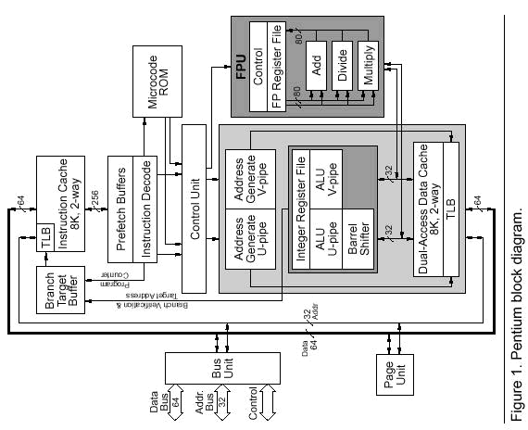
Don’t need to know this:

Slide 105
Computer Memory Hierarchy
CPU
CACHE
PRIMARY MEMORY
Almost always on chip
Almost always on motherboard
SECONDARY MEMORY
Hard drives, tape, external flash memory

Slide 106
Memory Concepts
Sequential vs. Non-sequential
E.g. magnetic tape vs. hard disk
Volatile vs. Non-volatile
Volatile: looses memory on power off
Non-Volatile: retains memory on power off
Protection
Preventing one program from altering memory contents of another program
This is bad:
Thanks! I’ll just borrow this…
Evil Program
Trusted Program

Slide 107
Memory Types
Cache Memory
Temporarily holds instructions and data from primary memory that are likely to be used next
Random Access Memory (RAM)
Addressable
Stored data can be altered
Volatile
Read Only Memory (ROM)
Most cannot be altered
E.g. Fusible links and ROM set in fabrication masks
Some can be altered
EPROM, EAROM, EEPROM, Flash, others
Most have the letter “e” in front… stands for electronic… suggesting that it can be altered ‘somehow’
Programmable Logic Device (PLD)
ROM (Read Only Memory), PAL (Programmable Array Logic), CPLD (Complex Programmable Logic Device), FPGA (Field Programmable Gate Array)
Permanent (Fusible links and ROM set in fabrication masks)
Or… Volatile (SRAM latches to turn a MOS transistor on or off)
Write Once Read Memory

Slide 108
Storage Devices
Real or Primary memory
Directly accessible by the CPU
Memory you would typically find on the same motherboard as the CPU
Some form of RAM, DRAM, EDO RAM, SDRAM, DDR SDRAM, BEDO DRAM
Secondary Memory
E.g. magnetic disks (hard drive)
Provides non-volatile storage – meaning it survives power off
Virtual Memory
Extends apparent size of RAM
Often in Secondary Memory
E.g. Swap, Paging file

Slide 109

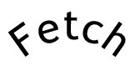
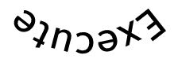
Instruction Execution Cycle: I
Basic machine cycle: Fetch & Execute
Retrieve instruction from addressed location in memory
Decode and execute instruction

Slide 110
Instruction Execution Cycle: II
Pipelining: Sequentially lining up the execution cycles of multiple instruction sets to get the most out of the CPU which is _executing_ the instructions… e.g.:
Complex Instruction Set Computer (CISC): Single fetch would capture multiple instructions. Fetch used to take long time. Instruction now can say:
“make a sandwich” instead of
“get bread” “get mustard” “spread mustard”…
Reduced Instruction Set Computer (RISC): E.g. Dragonball processor for original Palm Pilots; simple instructions, require fewer clock cycles
Fetch
Decode
Execute
Fetch
Decode
Execute
Fetch
Decode
Execute

Slide 111
Instruction Execution Cycle: II
Scalar Processor: One instruction at a time
Superscalar Processor: Concurrent execution of multiple instructions in the same pipeline stage as well as in different pipeline stages
Very-Long-Instruction-Word Processor (VLIW): Single instruction calls multiple concurrent operations
In the previous slide – picture two parallel execution lines called by the same instruction
Multi-Tasking: Execute multiple tasks or sub-programs on single CPU by alternating execution among programs
(Pre-emptive vs. Cooperative)
Multi-Programming: Execute multiple programs on single CPU by alternating execution among programs
Multi-Processing: Execute multiple programs on multiple CPU s

Slide 112
Software
Machine language instructions
Assembly language
Low level language
Assembler – Generates object code from source code
Cross assembler – running on another system
Dis-assembler – reverses assembler
High level languages use Interpreters
See next slide:
1 GL – machine language
2 GL – assembly
3 GL – Fortran, Basic, etc
4 GL – Natural, Focus, SQL
5 GL – Artificial intelligence languages (LISP)

Slide 113
Five Generations of Software

Slide 114
Open vs. Closed Systems
Open
Vendor independent
Published specifications and interfaces
Often open to products from other suppliers
Subject to review and evaluation by independent parties, often revealing errors and vulnerabilities
Closed
Vendor dependent
Private specifications and interfaces
Often closed to products from other suppliers
Not subject to independent review and evaluation by other parties, often concealing errors and vulnerabilities

Slide 115
Distributed Systems & Architecture

Slide 116
Challenges & Concerns
Desktop systems have sensitive information
User education
Distributed network nodes increases network attack surface area
Rogue and incorrectly configured modems
Downloaded and installed executables from the Internet and/or personal programs
Physical protection of distributed assets different from locked down data center
Data backup

Slide 117
Security Mechanisms & Counters
Policies
Solid access controls
E.g. Multi-factor authentication, biometrics
File encryption; monitoring software
Computer cable locks and lockable storage containers
Centralized backup of data files
Regular security awareness training sessions
Application level controls
Correctly classifying data
Logging events
Formal software development methods

Slide 118
Protection Mechanisms

Slide 119
Rings
Security Kernel: HW, firmware, SW elements of a trusted computing base that implement the reference monitor concept
Reference Monitor: system component that enforces access controls on an object
Security Kernel MUST:
Mediate all access
Be protected from modification
Be verified as correct
Other related kernel-level approaches:
Separate HW device that verifies system
Use of virtual machines with difference security levels
Use of separate security kernel operating in confines of hardware protected environment
3
2
1
0

Slide 120
Security Labels
Indicate special security handling
Sometimes used for access control
Usually cannot be altered (easily) once applied
Used in conjunction with security policy
Incurs additional overhead from the additional policy comparison and processing
Evaluated and used in accordance with a strong security policy

Slide 121
Security Modes
System High Mode of Operation
Operates at the highest level of information classification where all users must have clearances for the highest level
Multilevel Mode of Operation
Supports users with different clearances and data at multiple classification levels
Dedicated
Everyone has clearance and need to know
Possible to handle more than one classification type
Compartmented
Everyone has clearance, but not need to know
Controlled
Type of multilevel security where limited trust is placed in system (HW/SW) and on the data (restrictions on the classification of the information levels that can be processed
Limited Access
Minimum user clearance is not cleared and the maximum data classification is unclassified but sensitive

Slide 122
Additional Security Considerations
Covert Channel
Unintended communication path, e.g. sniped common storage area or communications path
Lack of Parameter Checking
Failure to check size or validate content of input data
Maintenance Hook (or “Trapdoor”)
Subverted maintenance SW that bypasses security mechanisms
Time of Check to Time of Use (TOC/TOU) Attack
Exploits that difference in the time that security controls were applied and the time that authorized service was used

Slide 123
Recovery Procedures
Maintenance Mode
Only privileged users from privileged terminals
Fault Tolerance
System must be capable of detecting and rectifying the problem, maintaining system operations
Fail Safe – program execution is terminated, and the system is protected from being compromised
Fail Soft or “Resilient” – non-critical processing terminated, allowing system to continue processing
Failover – switching to a duplicate “hot” backup component in real-time, allowing system to continue processing
Cold Start – system failure – fault tolerance fails – requires employing maintenance mode

Slide 124
ASSURANCE
Degrees of confidence in satisfaction of security needs.

Slide 125
Evaluation Criteria

Slide 126
TCSEC
Level D. Minimal protection
Level C. Discretionary protection
Level B. Mandatory protection
Level A. Verified protection; formal methods
A indicates highest level of trust
Numbers indicate levels within major groups
Greater number indicates more stringent security requirements
Levels through B1 might be add on measures to existing operating an existing operating system
At levels B2 and above security must be included in the design of the operating system
A1 systems are completely verified

Slide 127
TCSEC – Model
D - Minimal Protection
Reserved for those systems that have been evaluated but that fail to meet the requirements for a higher evaluation class.
C - Discretionary Protection
C1 - Discretionary Security Protection
separation of users and data
DAC capable of enforcing access limitations on an individual basis
C2 – Controlled Access Protection
more finely grained DAC
individual accountability through login procedures
audit trails
resource isolation
B – Mandatory Protection
B1 – Labeled Security Protection
informal statement of the security policy model
data sensitivity labels
MAC over select subjects and objects
label exportation capabilities
all discovered flaws must be removed or otherwise mitigated
Source: http://en.wikipedia.org/wiki/TCSEC

Slide 128
TCSEC – Model (cont)
B2 – Structured Protection
clearly defined and documented formal security policy model
discretionary and mandatory access control enforcement be extended to all subjects and objects
covert storage channels are analyzed for occurrence and bandwidth
carefully structured into protection-critical and non-protection-critical elements
design and implementation enable more comprehensive testing and review
authentication mechanisms are strengthened
trusted facility management is provided administrator and operator segregation
strict configuration management controls are imposed
B3 - Security Domains
satisfies reference monitor requirements
structured to exclude code not essential to security policy enforcement
significant system engineering directed toward minimizing complexity
a security administrator is supported
audit security-relevant events
automated imminent intrusion detection, notification, and response
trusted system recovery procedures
covert timing channels are analyzed for occurrence and bandwidth
A - Verified Protection
A1 - Verified Design
functionally identical to B3
formal design and verification techniques including a formal top-level specification
formal management and distribution procedures
Source: http://en.wikipedia.org/wiki/TCSEC

Slide 129
ITSEC
European Information Technology Security Evaluation Criteria
TOE (Target of Evaluation): system to be evaluated
Separately evaluates functionality and assurance; includes:
10 functionality classes “F”
8 assurance levels “A”
7 levels of correctness “E”
8 basic security functions

Slide 130
Common Criteria
TCSEC, ITSEC, and the Canadian Trusted Computer Product Evaluation Criteria (CTCPEC) evolved into CC (Common Criteria)
Organized around Trusted Computing Base entities
TCB – combination of protection mechanism within a computer system, which includes the hardware , software, and firmware, that are trusted to enforce a security policy
Physical and logical controls
Startup and recovery
Reference mediation
Privileged states

Slide 131
Certification & Accreditation

Slide 132
Certification & Accreditation
Certification
Comprehensive evaluation of technical and non technical controls of system and other safeguards, to establish the extent in which a particular design and implementation meets specific security requirements.
Accreditation
Formal declaration by a DAA (Designated Approving Authority) where an information system is approved to operate in a particular security mode using a prescribed set of safeguards at an acceptable level of risk
When re-certification or re-accreditation required:
After defined period of time
Changes in the system or environment

Slide 133
DITSCAP
Defense Information Technology Security Certification and Accreditation Process (DITSCAP)
Four phases:
Definition (think Planning)
Verification (think Design)
Use the SSAA (System Security Authorization Agreement) to establish an evolving and binding agreement on the level of security a system is slated to meet.
Validation (think Implement)
Post Accreditation (think Operations)

Slide 134
NIACAP
National Information Assurance Certification and Accreditation Process (NIACAP)
Minimum national standards for certifying and accrediting national security systems
Three types:
Site
Evaluates system for use at specific location
Type
Evaluates system “type” for use at multiple locations
System
Evaluates major application (or general support system)

Slide 135
Access Control Models

Slide 136
Lattice Models
Every resource and every user of a resource is associated with an ordered set of classes
Resources associated with a particular class may be used only by people whose associated class is as high – or higher – than the associated resources
Joe has “Secret” clearance
TS
Joe with secret clearance can handle everything with a lower classification
Secret
Confidential
Unclassified

Slide 137
Bell-LaPadula Model
Developed by Bell and LaPadula
Remedies malicious classification downgrading
Results in two properties:
Processes with a given classification cannot read processes with a greater classification
Processes with a given classification cannot write into processes with a lower classification
Joe has “Secret” clearance
Joe cannot read TS Data
TS
Joe with a Secret clearance can read lower… but cannot write data with a lower classification
Secret
Confidential
Unclassified

Slide 138
Bell-LaPadula Model & MLS & MAC
MLS -- A system that employs the Bell-LaPadula model is called a multilevel security system because users with different clearances use the system, and the system processes data at different classification levels.
The level at which information is classified determines the handling procedures that should be used.
The Bell-LaPadula model is a state machine model that enforces the confidentiality aspects of access control.
A matrix and security levels are used to determine if subjects can access different objects.
MAC -- Subject’s clearance is compared to the object’s classification and then specific rules are applied to control how subject-to-object interactions can take place.
Notes:
A system that employs the Bell-LaPadula model is called a multilevel security system because users with different clearances use the system, and the system processes data at different classification levels. The level at which information is classified determines the handling procedures that should be used. The Bell-LaPadula model is a state machine model that enforces the confidentiality aspects of access control. A matrix and security levels are used to determine if subjects can access different objects. The subject’s clearance is compared to the object’s classification and then specific rules are applied to control how subject-to-object interactions can take place.
Harris, Shon (2012-11-08). CISSP All-in-One Exam Guide, 6th Edition (Kindle Locations 7756-7758). McGraw-Hill Education. Kindle Edition.

Slide 139
Bell-LaPadula Model & Secure State
The state of a system changes as different operations take place.
The Bell-LaPadula model defines a secure state, meaning a secure computing environment and the allowed actions, which are security-preserving operations.
This means the model provides a secure state and only permits operations that will keep the system within a secure state and not let it enter into an insecure state.
Basic Security Theorem -- used in computer science, states that if a system initializes in a secure state and all allowed state transitions are secure, then every subsequent state will be secure no matter what inputs occur.
Notes:
The state of a system changes as different operations take place. The Bell-LaPadula model defines a secure state, meaning a secure computing environment and the allowed actions, which are security-preserving operations. This means the model provides a secure state and only permits operations that will keep the system within a secure state and not let it enter into an insecure state. So if 100 people access 2,000 objects in a day using this one system, this system is put through a lot of work and several complex activities must take place. However, at the end of the day, the system is just as secure as it was at the beginning of the day. This is the definition of the Basic Security Theorem used in computer science, which states that if a system initializes in a secure state and all allowed state transitions are secure, then every subsequent state will be secure no matter what inputs occur.
Harris, Shon (2012-11-08). CISSP All-in-One Exam Guide, 6th Edition (Kindle Locations 7756-7758). McGraw-Hill Education. Kindle Edition.

Slide 140
Bell-LaPadula Model & ds-property
Discretionary Security Property (ds-property)
Another property of Bell-LaPadula Model.
This rule is based on named subjects and objects.
It dictates that specific permissions allow a subject to pass on permissions at its own discretion.
These permissions are stored in an access matrix.
This just means that mandatory and discretionary access control mechanisms can be implemented in one operating system.
Notes:
You may run into the Bell-LaPadula rule called Discretionary Security Property (ds-property), which is another property of this model. This rule is based on named subjects and objects. It dictates that specific permissions allow a subject to pass on permissions at its own discretion. These permissions are stored in an access matrix. This just means that mandatory and discretionary access control mechanisms can be implemented in one operating system.
Harris, Shon (2012-11-08). CISSP All-in-One Exam Guide, 6th Edition (Kindle Locations 7782-7785). McGraw-Hill Education. Kindle Edition.

Slide 141
Bell-LaPadula Model – Rules
The main rules of the Bell-LaPadula model are:
Simple security rule -- A subject cannot read data within an object that resides at a higher security level (the “no read up” rule).
*-property rule -- A subject cannot write to an object at a lower security level (the “no write down” rule).
Strong star property rule -- For a subject to be able to read and write to an object, the subject’s clearance and the object’s classification must be equal.
Notes:
The main rules of the Bell-LaPadula model are: • Simple security rule A subject cannot read data within an object that resides at a higher security level (the “no read up” rule). • *-property rule A subject cannot write to an object at a lower security level (the “no write down” rule). • Strong star property rule For a subject to be able to read and write to an object, the subject’s clearance and the object’s classification must be equal.
Harris, Shon (2012-11-08). CISSP All-in-One Exam Guide, 6th Edition (Kindle Locations 7786-7790). McGraw-Hill Education. Kindle Edition.

Slide 142
Biba Model - OR - Biba Integrity Model
Developed by Biba after studying Bell-LaPadula
Wanted to address Integrity specifically
The maintenance of integrity requires that data not flow from a receptacle of given integrity to a receptacle of higher integrity
Joe cannot contaminate Bob’s data.
Bob has “TS” clearance
Joe has “Secret” clearance
It’s all about Data Integrity
TS
Joe with a Secret clearance cannot write down,
or read up.
Secret
Confidential
Unclassified

Slide 143
Biba Integrity Model
Has following three goals:
Data is protected from modification by unauthorized users
Data is protected from unauthorized modification by authorized users
Data is internally and externally consistent
Has following three integrity axioms:
Simple Integrity Axiom – No read down – subject at one level of integrity is not permitted to observe (read) an object of a lower integrity
Star Integrity Axiom – No write up – an object at one level o integrity is not permitted to modify (write to) an object of a higher level of integrity
A subject at one level of integrity cannot invoke a subject at a higher level of integrity

Slide 144
Biba Model – Rules (Restating for Clarity)
Biba has three main rules:
*-integrity axiom -- A subject cannot write data to an object at a higher integrity level (referred to as “no write up”).
Simple integrity axiom -- A subject cannot read data from a lower integrity level (referred to as “no read down”).
Invocation property -- A subject cannot request service (invoke) of higher integrity.
Notes:
Biba has three main rules to provide this type of protection: • *-integrity axiom A subject cannot write data to an object at a higher integrity level (referred to as “no write up”). • Simple integrity axiom A subject cannot read data from a lower integrity level (referred to as “no read down”). • Invocation property A subject cannot request service (invoke) of higher integrity.
Harris, Shon (2012-11-08). CISSP All-in-One Exam Guide, 6th Edition (Kindle Locations 7796-7800). McGraw-Hill Education. Kindle Edition.

Slide 145
Clark-Wilson Model – Rules
The Clark-Wilson model was developed after Biba and takes some different approaches to protecting the integrity of information.
This model uses the following elements:
Users -- Active agents
Transformation procedures (TPs) -- Programmed abstract operations, such as read, write, and modify
Constrained data items (CDIs) -- Can be manipulated only by TPs
Unconstrained data items (UDIs ) -- Can be manipulated by users via primitive read and write operations
Integrity verification procedures (IVPs) -- Check the consistency of CDIs with external reality
Notes:
Clark-Wilson Model The Clark-Wilson model was developed after Biba and takes some different approaches to protecting the integrity of information. This model uses the following elements: • Users Active agents • Transformation procedures (TPs) Programmed abstract operations, such as read, write, and modify • Constrained data items (CDIs) Can be manipulated only by TPs • Unconstrained data items (UDIs ) Can be manipulated by users via primitive read and write operations • Integrity verification procedures (IVPs) Check the consistency of CDIs with external reality
Although this list may look overwhelming, it is really quite straightforward. When an application uses the Clark-Wilson model, it separates data into one subset that needs to be highly protected, which is referred to as a constrained data item (CDI), and another subset that does not require a high level of protection, which is called an unconstrained data item (UDI). Users cannot modify critical data (CDI) directly. Instead, the subject (user) must be authenticated to a piece of software, and the software procedures (TPs) will carry out the operations on behalf of the user. For example, when Kathy needs to update information held within her company’s database, she will not be allowed to do so without a piece of software controlling these activities. First, Kathy must authenticate to a program, which is acting as a front end for the database, and then the program will control what Kathy can and cannot do to the information in the database. This is referred to as access triple: subject (user), program (TP), and object (CDI). A user cannot modify CDI without using a TP. So, Kathy is going to input data, which is supposed to overwrite some original data in the database. The software (TP) has to make sure this type of activity is secure and will carry out the write procedures for Kathy. Kathy (and any type of subject) is not trusted enough to manipulate objects directly. The CDI must have its integrity protected by the TPs. The UDI does not require such a high level of protection. For example, if Kathy did her banking online, the data on her bank’s servers and databases would be split into UDI and CDI categories. The CDI category would contain her banking account information, which needs to be highly protected. The UDI data could be her customer profile, which she can update as needed. TPs would not be required when Kathy needed to update her UDI information. In some cases, a system may need to change UDI data into CDI data. For example, when Kathy updates her customer profile via the website to show her new correct address, this information will need to be moved into the banking software that is responsible for mailing out bank account information. The bank would not want Kathy to interact directly with that banking software, so a piece of software (TP) is responsible for copying that data and updating this customer’s mailing address. At this stage, the TP is changing the state of the UDI data to CDI. These concepts are shown in Figure 4-23 .
Harris, Shon (2012-11-08). CISSP All-in-One Exam Guide, 6th Edition (Kindle Locations 7839-7857). McGraw-Hill Education. Kindle Edition.
Harris, Shon (2012-11-08). CISSP All-in-One Exam Guide, 6th Edition (Kindle Locations 7833-7839). McGraw-Hill Education. Kindle Edition.

Slide 146
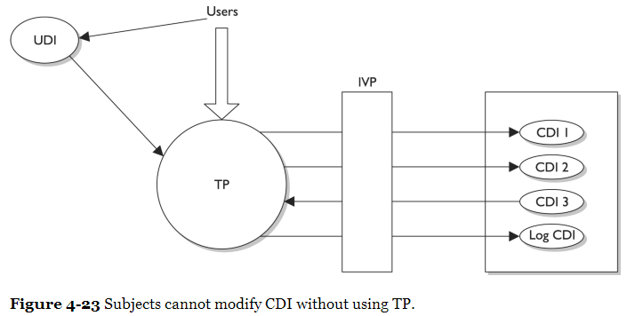
Clark-Wilson Model

Slide 147
Models and Software Development
“What are the specific defined integrity rules that the IVP must comply with?”
“Whatever the vendor chooses them to be.”
A model is made up of constructs, mathematical formulas, and other PhD stuff.
The model provides the framework that can be used to build a certain characteristic into software (confidentiality, integrity).
The model does not stipulate specific integrity rules
So the vendor who develops the product will determine what type of data is considered UDI and what type of data is CDI and develop the TPs to control and orchestrate how the software enforces the integrity of the CDI values.
Notes:
A model is made up of constructs, mathematical formulas, and other PhD kinds of stuff. The model provides the framework that can be used to build a certain characteristic into software (confidentiality, integrity). So the model does not stipulate what specific integrity rules the IVP must enforce; it just provides the framework, and the vendor defines the integrity rules that best fits its product’s requirements. The vendor implements integrity rules that its customer base needs the most. So if a vendor is developing an application for a financial institution, the UDI could be customer profiles that they are allowed to update and the CDI could be the bank account information, usually held on a centralized database. The UDI data do not need to be as highly protected and can be located on the same system or another system. A user can have access to UDI data without the use of a TP, but when the user needs to access CDI, they must use TP.
So the vendor who develops the product will determine what type of data is considered UDI and what type of data is CDI and develop the TPs to control and orchestrate how the software enforces the integrity of the CDI values. In a banking application, the IVP would ensure that the CDI represents the correct value. For example, if Kathy has $ 2,000 in her account and then deposits $ 50, the CDI for her account should now have a value of $ 2,050. The IVP ensures the consistency of the data. So after Kathy carries out this transaction and the IVP validates the integrity of the CDI (new bank account value is correct), then the CDI is considered to be in a consistent state. TPs are the only components allowed to modify the state of the CDIs. In our example, TPs would be software procedures that carry out deposit, withdrawal, and transfer functionalities. Using TPs to modify CDIs is referred to as a well-formed transaction. A well-formed transaction is a series of operations that are carried out to transfer the data from one consistent state to the other. If Kathy transfers money from her checking account to her savings account, this transaction is made up of two operations: subtract money from one account and add it to a different account. By making sure the new values in her checking and savings accounts are accurate and their integrity is intact, the IVP maintains internal and external consistency. The Clark-Wilson model also outlines how to incorporate separation of duties into the architecture of an application . If we follow our same example of banking software , if a customer needs to withdraw over $ 10,000, the application may require a supervisor to log in and authenticate this transaction. This is a countermeasure against potential fraudulent activities. The model provides the rules that the developers must follow to properly implement and enforce separation of duties through software procedures.
Harris, Shon (2012-11-08). CISSP All-in-One Exam Guide, 6th Edition (Kindle Locations 7876-7883). McGraw-Hill Education. Kindle Edition.
Harris, Shon (2012-11-08). CISSP All-in-One Exam Guide, 6th Edition (Kindle Locations 7863-7876). McGraw-Hill Education. Kindle Edition.

Slide 148
Goals of Integrity Models
The following are the three main goals of integrity models:
Prevent unauthorized users from making modifications
Prevent authorized users from making improper modifications (separation of duties)
Maintain internal and external consistency (well-formed transaction)
Biba only addresses the first goal.
Clark-Wilson addresses each of these goals in its model.
The Clark-Wilson model enforces the three goals of integrity by using: well-formed transactions through access triple (subject, software [TP], object), separation of duties, and auditing.
Notes:
The following are the three main goals of integrity models: • Prevent unauthorized users from making modifications • Prevent authorized users from making improper modifications (separation of duties) • Maintain internal and external consistency (well-formed transaction)
Clark-Wilson addresses each of these goals in its model.
Biba only addresses the first goal.
The Clark-Wilson model enforces the three goals of integrity by using access triple (subject, software [TP], object), separation of duties, and auditing.
Harris, Shon (2012-11-08). CISSP All-in-One Exam Guide, 6th Edition (Kindle Locations 7888-7892). McGraw-Hill Education. Kindle Edition.
Harris, Shon (2012-11-08). CISSP All-in-One Exam Guide, 6th Edition (Kindle Locations 7885-7888). McGraw-Hill Education. Kindle Edition.

Slide 149
Security Models Recap
Bell-LaPadula model -- This is the first mathematical model of a multilevel security policy that defines the concept of a secure state and necessary modes of access. It ensures that information only flows in a manner that does not violate the system policy and is confidentiality focused.
The simple security rule -- A subject cannot read data at a higher security level (no read up).
The *-property rule -- A subject cannot write to an object at a lower security level (no write down).
The strong star property rule -- A subject can perform read and write functions only to the objects at its same security level.
Notes:
Bell-LaPadula model -- This is the first mathematical model of a multilevel security policy that defines the concept of a secure state and necessary modes of access. It ensures that information only flows in a manner that does not violate the system policy and is confidentiality focused.
The simple security rule -- A subject cannot read data at a higher security level (no read up).
The *-property rule -- A subject cannot write to an object at a lower security level (no write down).
The strong star property rule -- A subject can perform read and write functions only to the objects at its same security level.
Biba model -- A formal state transition model that describes a set of access control rules designed to ensure data integrity.
The simple integrity axiom -- A subject cannot read data at a lower integrity level (no read down).
The *-integrity axiom -- A subject cannot modify an object in a higher integrity level (no write up).
Clark-Wilson model -- This integrity model is implemented to protect the integrity of data and to ensure that properly formatted transactions take place. It addresses all three goals of integrity:
Subjects can access objects only through authorized programs (access triple).
Separation of duties is enforced.
Auditing is required.
Additional models
Information flow model -- This is a model in which information is restricted in its flow to only go to and from entities in a way that does not negate or violate the security policy.
Noninterference model -- This formal multilevel security model states that commands and activities performed at one security level should not be seen by, or affect, subjects or objects at a different security level.
Brewer and Nash model -- This model allows for dynamically changing access controls that protect against conflicts of interest. Also known as the Chinese Wall model.
Graham-Denning model -- This model shows how subjects and objects should be created and deleted. It also addresses how to assign specific access rights.
Harrison-Ruzzo-Ullman model -- This model shows how a finite set of procedures can be available to edit the access rights of a subject.

Slide 150
Security Models Recap
Biba model -- A formal state transition model that describes a set of access control rules designed to ensure data integrity.
The simple integrity axiom -- A subject cannot read data at a lower integrity level (no read down).
The *-integrity axiom -- A subject cannot modify an object in a higher integrity level (no write up).
Clark-Wilson model -- This integrity model is implemented to protect the integrity of data and to ensure that properly formatted transactions take place. It addresses all three goals of integrity:
Subjects can access objects only through authorized programs (access triple).
Separation of duties is enforced.
Auditing is required.
Notes:
Bell-LaPadula model -- This is the first mathematical model of a multilevel security policy that defines the concept of a secure state and necessary modes of access. It ensures that information only flows in a manner that does not violate the system policy and is confidentiality focused.
The simple security rule -- A subject cannot read data at a higher security level (no read up).
The *-property rule -- A subject cannot write to an object at a lower security level (no write down).
The strong star property rule -- A subject can perform read and write functions only to the objects at its same security level.
Biba model -- A formal state transition model that describes a set of access control rules designed to ensure data integrity.
The simple integrity axiom -- A subject cannot read data at a lower integrity level (no read down).
The *-integrity axiom -- A subject cannot modify an object in a higher integrity level (no write up).
Clark-Wilson model -- This integrity model is implemented to protect the integrity of data and to ensure that properly formatted transactions take place. It addresses all three goals of integrity:
Subjects can access objects only through authorized programs (access triple).
Separation of duties is enforced.
Auditing is required.
Additional models
Information flow model -- This is a model in which information is restricted in its flow to only go to and from entities in a way that does not negate or violate the security policy.
Noninterference model -- This formal multilevel security model states that commands and activities performed at one security level should not be seen by, or affect, subjects or objects at a different security level.
Brewer and Nash model -- This model allows for dynamically changing access controls that protect against conflicts of interest. Also known as the Chinese Wall model.
Graham-Denning model -- This model shows how subjects and objects should be created and deleted. It also addresses how to assign specific access rights.
Harrison-Ruzzo-Ullman model -- This model shows how a finite set of procedures can be available to edit the access rights of a subject.

Slide 151
Additional Security Models
Information flow model -- This is a model in which information is restricted in its flow to only go to and from entities in a way that does not negate or violate the security policy.
Noninterference model -- This formal multilevel security model states that commands and activities performed at one security level should not be seen by, or affect, subjects or objects at a different security level.
Brewer and Nash model -- This model allows for dynamically changing access controls that protect against conflicts of interest. Also known as the Chinese Wall model.
Graham-Denning model -- This model shows how subjects and objects should be created and deleted. It also addresses how to assign specific access rights.
Harrison-Ruzzo-Ullman model -- This model shows how a finite set of procedures can be available to edit the access rights of a subject.
Notes:
Bell-LaPadula model -- This is the first mathematical model of a multilevel security policy that defines the concept of a secure state and necessary modes of access. It ensures that information only flows in a manner that does not violate the system policy and is confidentiality focused.
The simple security rule -- A subject cannot read data at a higher security level (no read up).
The *-property rule -- A subject cannot write to an object at a lower security level (no write down).
The strong star property rule -- A subject can perform read and write functions only to the objects at its same security level.
Biba model -- A formal state transition model that describes a set of access control rules designed to ensure data integrity.
The simple integrity axiom -- A subject cannot read data at a lower integrity level (no read down).
The *-integrity axiom -- A subject cannot modify an object in a higher integrity level (no write up).
Clark-Wilson model -- This integrity model is implemented to protect the integrity of data and to ensure that properly formatted transactions take place. It addresses all three goals of integrity:
Subjects can access objects only through authorized programs (access triple).
Separation of duties is enforced.
Auditing is required.
Additional models
Information flow model -- This is a model in which information is restricted in its flow to only go to and from entities in a way that does not negate or violate the security policy.
Noninterference model -- This formal multilevel security model states that commands and activities performed at one security level should not be seen by, or affect, subjects or objects at a different security level.
Brewer and Nash model -- This model allows for dynamically changing access controls that protect against conflicts of interest. Also known as the Chinese Wall model.
Graham-Denning model -- This model shows how subjects and objects should be created and deleted. It also addresses how to assign specific access rights.
Harrison-Ruzzo-Ullman model -- This model shows how a finite set of procedures can be available to edit the access rights of a subject.

Slide 152
Security Modes

Slide 153
Dedicated Security Mode
All users must have …
Proper clearance for all information on the system
Formal access approval for all information on the system
A signed NDA for all information on the system
A valid need-to-know for all information on the system
All users can access all data.

Slide 154
System High-Security Mode
All users must have …
Proper clearance for all information on the system
Formal access approval for all information on the system
A signed NDA for all information on the system
A valid need-to-know for some information on the system
All users can access some data, based on their need-to-know.

Slide 155
Compartmented Security Mode
All users must have …
Proper clearance for the highest level of data classification on the system
Formal access approval for some information on the system
A signed NDA for all information they will access on the system
A valid need-to-know for some of the information on the system
All users can access some data, based on their need-to-know and formal access approval.

Slide 156
Multilevel Security Mode
All users must have …
Proper clearance for some of the information on the system
Formal access approval for some of the information on the system
A signed NDA for all information on the system
A valid need-to-know for some of the information on the system
All users can access some data, based on their need-to-know, clearance, and formal access approval.

Slide 157
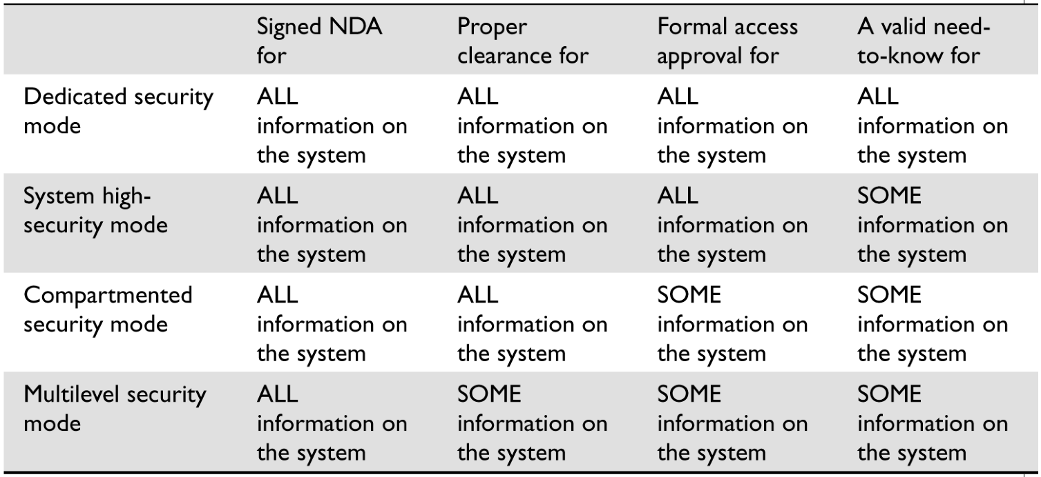
Security Modes

Slide 158
Additional Concepts

Slide 159
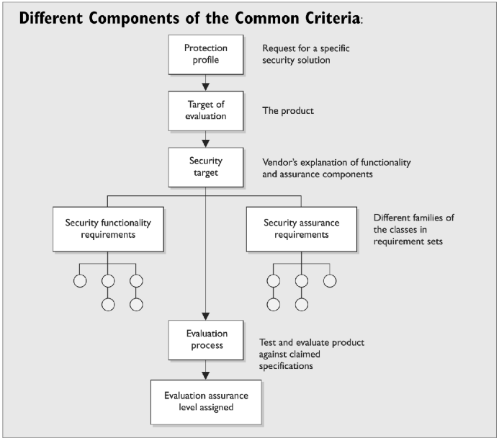
Common Criteria
Notes:
• Protection profile Description of a needed security solution. • Target of evaluation Product proposed to provide a needed security solution. • Security target Vendor’s written explanation of the security functionality and assurance mechanisms that meet the needed security solution— in other words, “This is what our product does and how it does it.” • Security functional requirements Individual security functions which must be provided by a product. • Security assurance requirements Measures taken during development and evaluation of the product to assure compliance with the claimed security functionality. • Packages— EALs Functional and assurance requirements are bundled into packages for reuse. This component describes what must be met to achieve specific EAL ratings.
Harris, Shon (2012-11-08). CISSP All-in-One Exam Guide, 6th Edition (Kindle Locations 8468-8475). McGraw-Hill Education. Kindle Edition.

Slide 160
Certification vs. Accreditation
Certification is the comprehensive technical evaluation of the security components and their compliance for the purpose of accreditation.
Accreditation is the formal acceptance of the adequacy of a system’s overall security and functionality by management.
Notes:
Certification is the comprehensive technical evaluation of the security components and their compliance for the purpose of accreditation. Accreditation is the formal acceptance of the adequacy of a system’s overall security and functionality by management.
Harris, Shon (2012-11-08). CISSP All-in-One Exam Guide, 6th Edition (Kindle Locations 8497-8512). McGraw-Hill Education. Kindle Edition.

Slide 161
Additional Key Terms
Assurance evaluation criteria -- “Checklist” and process of examining the security-relevant parts of a system (TCB, reference monitor, security kernel) and assigning the system an assurance rating.
Trusted Computer System Evaluation Criteria (TCSEC) (aka Orange Book) -- U.S. DoD standard used to assess the effectiveness of the security controls built into a system. Replaced by the Common Criteria.
Information Technology Security Evaluation Criteria (ITSEC) -- European standard used to assess the effectiveness of the security controls built into a system.
Common Criteria -- International standard used to assess the effectiveness of the security controls built into a system from functional and assurance perspectives.
Certification -- Technical evaluation of the security components and their compliance to a predefined security policy for the purpose of accreditation.
Accreditation -- Formal acceptance of the adequacy of a system’s overall security by management.

Slide 162
Additional Key Terms
Open system -- Designs are built upon accepted standards to allow for interoperability.
Closed system -- Designs are built upon proprietary procedures, which inhibit interoperability capabilities.
Maintenance hooks -- Code within software that provides a back door entry capability.
Time-of-check/ time-of-use (TOC/ TOU) attack -- Attacker manipulates the “condition check” step and the “use” step within software to allow for unauthorized activity.
Race condition -- Two or more processes attempt to carry out their activity on one resource at the same time. Unexpected behavior can result if the sequence of execution does not take place in the proper order.

Slide 163
Final Thoughts

Slide 164
Final Thoughts

Slide 165
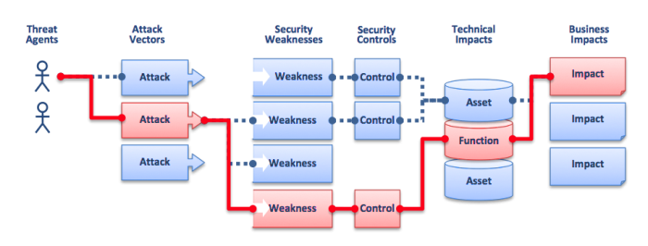
OWASP Risk Rating Methodology
Source: https://www.owasp.org/index.php/Top_10_2010-Main Last visited 9/21/2014.

Slide 166
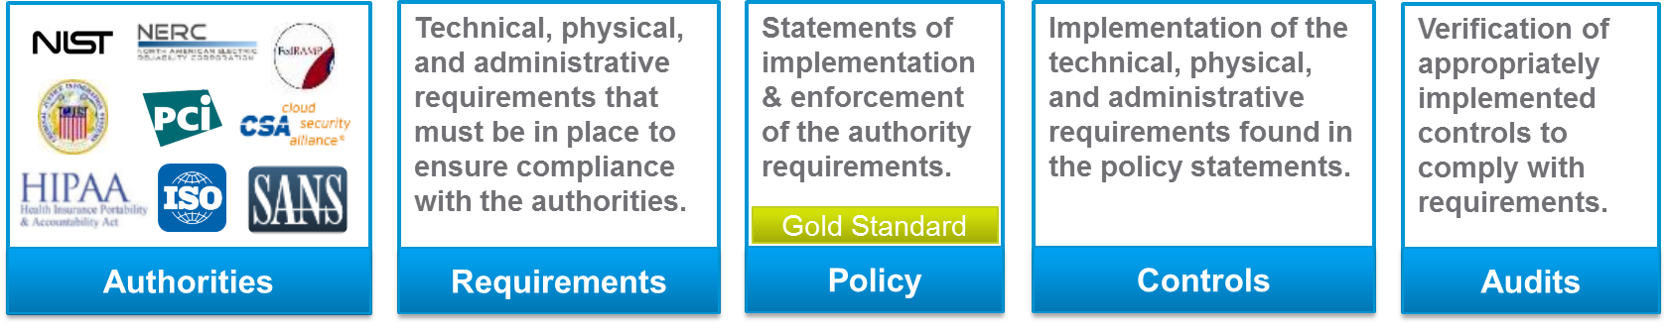
From Authorities to Audits
PCI-DSS Example
Authority: PCI-DSS is the authority document created by the PCI-SSC.
Requirement: (10.6) Review logs for all system components at least daily.
Policy: Monitoring Policy – States logs will be reviewed at least daily.
Control: Tool XYZ provides real-time monitoring for all system components.
Audit: Auditor verifies Tool XYZ is appropriately monitoring and alerting to actionable events. Audit results and evidence are stored as part of the audit.

Slide 167
Effectively Managed IT Controls
Technology can affect every part of the business.
At its best, technology is a competitive advantage.
At its worst, technology is your competitor’s advantage.
Product
Market Relationships
IT Controls:
Detective, protective and reactive measures in place to protect the confidentiality, integrity, and availability of business information and ensure appropriate management of the IT function to meet business objectives.
Inbound Logistics
Operations
Outbound Logistics
Marketing
and Sales
Service
Firm Infrastructure
HR Management
Margin
Procurement
Technology Development
Notes:
Compliance Control: A process, effected by management and other personnel, designed to provide reasonable assurance that transactions are executed in accordance with 1) laws governing the use of budget authority and other laws and regulations that could have a direct and material effect on the financial statements or required supplementary stewardship information and 2) any other laws, regulations, and government wide policies identified in OMB audit guidance. [GAO/PCIE Financial Audit Manual]
Source: http://www.unifiedcompliance.com/it_compliance/language_compliance/definitions/c.html

Slide 168
Chris Davis
UTD Email: cmd140430@utdallas.edu
Google Voice: 214-771-8122
Course Materials
https://elearning.utdallas.edu

Slide 169
Additional Materials

Slide 170
Today's Materials
Harris, Shon (2012-11-08).
CISSP All-in-One Exam Guide, 6th Edition.
McGraw-Hill Education.

